Slide 1
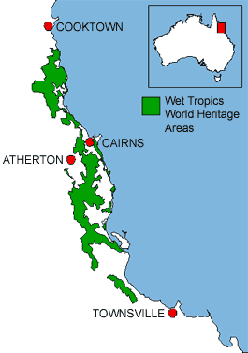
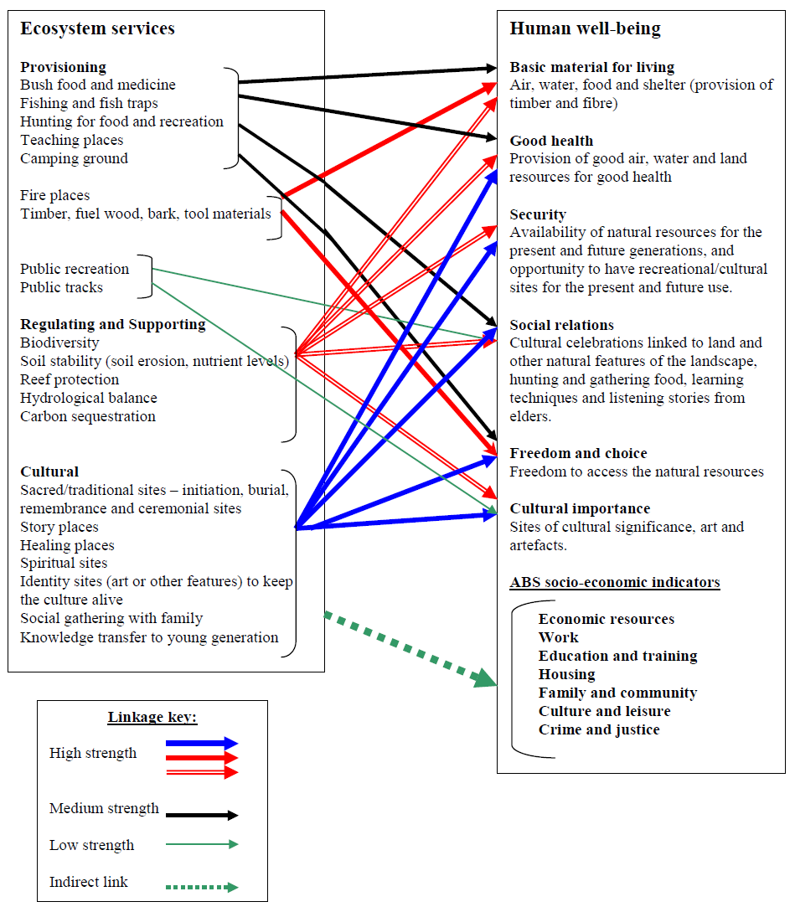
Application of the Millennium Assessment (MA) Framework in Australian Context
Kamaljit K Sangha, James Cook University, Qld, Australia
Email: kamaljit.kaur@jcu.edu.au
Study area
Introduction: We carried three protects in north Qld that applied the MA framework:
The role of ecosystem services in the well-being of Aboriginal people in savanna country (2004-06): a scoping study
Understanding the links between wild resources and Aboriginal well-being in the Wet Tropics (2006-07)
Socio-economic-ecological cost of pig infestation in the Wet Tropics World Heritage Area, Queensland (2009-2010)
Methodology: Focus group meetings, surveys and semi-structured interviews.
Main RESULTS
Results Project 3:
Impact of feral pigs on various ecosystem services from the rainforest in the Wet Tropics World Heritage Area (WTWHA), and subsequently their impact on the well-being of local communities (Indigenous and non-Indigenous, tourists and others) were explored.
This study highlights the applicability of the MA framework for those who live close to the nature than the urban communities.
References:
1. Kana Koichi, Kamaljit K. Sangha, Alison Cottrell and Iain Gordon (2010) ‘Indigenous perspectives on feral pigs: are they a pest or a resource? A case study of feral pigs (Sus scrofa) and Indigenous rangers in the Wet Tropics of Northern Queensland’. Submitted to the Journal of Australian Indigenous Issues.
2. Kana Koichi, Kamaljit K. Sangha, Alison Cottrell and Iain Gordon (2011) ‘Analysis of value frameworks (Millennium Ecosystem Assessment and Total Economic Value) to understand the public’s construction of environmental values’. Submitted to Environmental Values.
and others……
Project 1: A detailed outline, and a model developed to establish links between the well-being of Aboriginal people and the major ecosystem services from the savanna country. This research highlighted the major drawbacks in the currently applied socio-economic measures that fail to measure well-being of Aboriginal people.
References:
1. Kamaljit Kaur (2007). Linking ecosystem services to well-being: A case study of Aboriginal communities in north Australia. Australian Aboriginal Studies, Issue 2 (2007): 145-147.
2. Kamaljit Kaur (2006). The role of ecosystem services from tropical savannas in well-being of Aboriginal people: A scoping study. A report for the Tropical Savannas Cooperative Research Centre, Darwin, NT.
Results Project 2:
Case studies were conducted in north Qld, and links were established, through participatory research, between the well-being of Aboriginal people and the main ecosystem services from the rainforest ecosystems for the Mullunbara-Yidinji community.
References:
Kamaljit Kaur, James Burtler, Aurelie Delisle and Owen Stanley (2011). Identifying links between ecosystem services and Aboriginal well-being and livelihoods in north Australia: applying the Millennium Ecosystem Assessment framework. Journal of Environmental Science and Engineering (issue5, 2011), pp. 381-387.
Fig 1. Relationships between ecosystem services and the constituents of well-being identified by the Mullunburra-Yidinji community
About 80% of the residents surveyed believed that feral pigs diminished the environmental values that they ascribed to the rainforest because of the negative environmental impacts of pigs on the rainforest in the WTWHA.
Utility of MA framework (project 3):
The public, especially locals, tourists who did not have a direct relationship with the rainforest for their livelihood, dominantly expressed values associated with the existence of the rainforest (in isolation from their personal well-being).
Some stakeholders, particularly hunters, tourism operators and Aboriginal rangers, expressed values that were more specific to ecosystem services identified in the MA framework.
The utility of the MA framework may have been limited to those who had closer relationships with, or better understandings of the rainforests due to their profession or livelihood.
Table 1: Values identified by the locals (surveys and interviews) are categorized according to the MA and TEV (Total Economic Value) frameworks (n= 120)
Total Economic Value |  | Millennium Ecosystem Assessment |  | Quotes (Examples)
Use Value | Direct Use (Consumptive) | Provisioning Services | Food Medicine Fresh Water | The traditional food sources Fishing industry (from barrier reef which rainforest supports) Traditional medicinal sources Reservoir and source for as yet unknown drugs Water catchment | “Biodiversity” & “Ecological integrity”
 | Indirect Use | Regulating Services | Air regulation Climate regulation Erosion regulation | It is the breathing lung of the country/ the world’s lung/ air quality The air filter factor worldwide Rain production/stabilisation of climate/ climate effects Carbon sink/fixing/sequestration Reduction of run off to the reef/ runoff filtration/ reduce or stops erosion
Use & Non-use Value | Direct use (non-consumptive) + Option + Existence | Cultural Services | Recreation & Ecotourism Aesthetic values Educational values Cultural heritage values Inspiration | A money spinner for tourism, brings tourists – economic growth and so forth As an economic value to tourism and people’s enjoyment of their rainforest experience, Scientific research, the sheer beauty of it, Natural wonder/beauty, clean environment, it is beautiful and sacred. Protection for the study of plant and animal life Area of diverse ecosystem appreciated and used by several cultures of people The traditional medicinal and food sources to be passed down to the next generations to keep Aboriginal culture alive. It represents a 450 million year evolution of life and diversity
N/A |  | Supporting Services | Nutrient cycling Production of oxygen Soil formation & retention | Complex nutrient cycle Their production of Oxygen/ Oxygen producer Soil retention Protection of all rainforest animals – except pigs Breeding area for unique flora and fauna
Acknowledgements: Marine and Tropical Science Research Facility, Invasive Animals Co-operative Research Centre, CSIRO and JCU.

